Slide 1


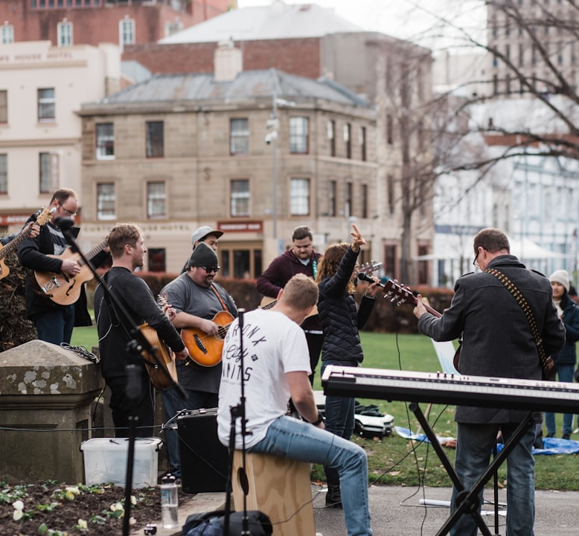


Evangelism
Department 2026
XXX

Slide 2


Who are our members?
ALL Workers

Slide 3

VISION STATEMENT
Going beyond a Statement, Services and Sermon through constant partnership with the Holy Spirit to enable us serve and inspire others to join us as disciples of Christ. (Gen 1:27, Mark 16:15)

Slide 4

MISSION
To bring the church outside of the building.
2.To create self-sustaining, evangelistic/discipleship outreach movements where Christians know their faith, share their faith, and grow their faith.
3.To move people from passive participation to active participation.
4. To train people on how to share the gospel and to help them discover how to incorporate evangelism in their daily lives.

Slide 5
MISSION
5. To focus as a church on Kingdom growth not on only church growth.
6. To organize outreach programs either monthly or quarterly for the purpose of sharing the gospel and creating awareness about the church.
7. To help push forward the existing strategy and to create new ways by the help of God to promote and increase church growth.

Slide 6

What are our
Strategies?

Slide 7
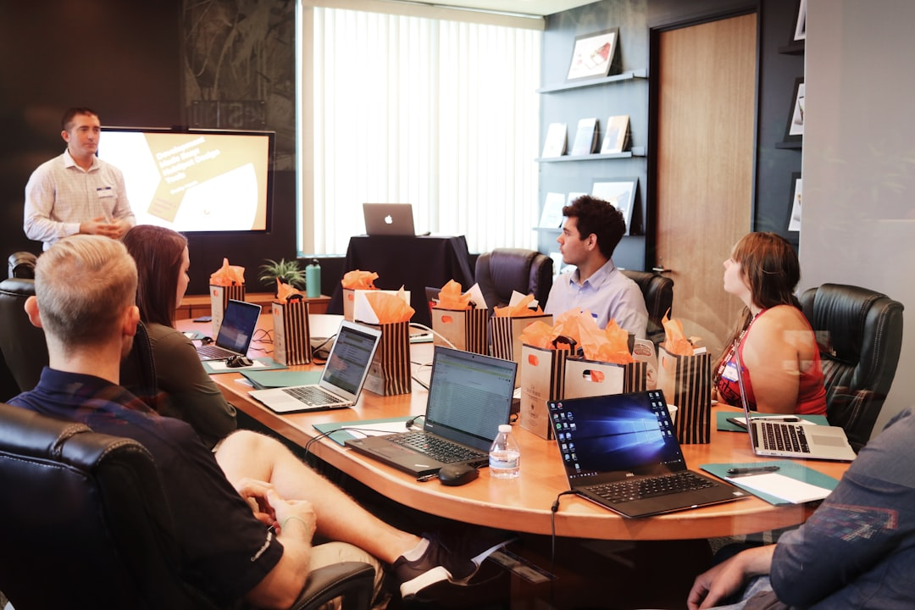
We start by empowering the workforce through training and development on evangelism.

Slide 8

By visiting hospitals in order to pray for the sick and share the gospel.

Slide 9
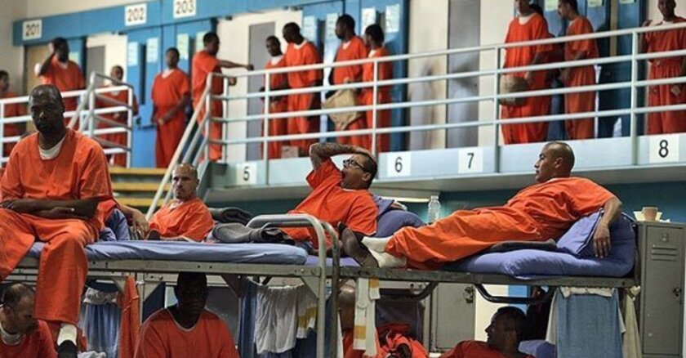
By visiting Prisons in order to pray and share the gospel.

Slide 10

By targeting immigrants either at the airport or through social media platforms and assisting them with the necessary guidance and support.

Slide 11
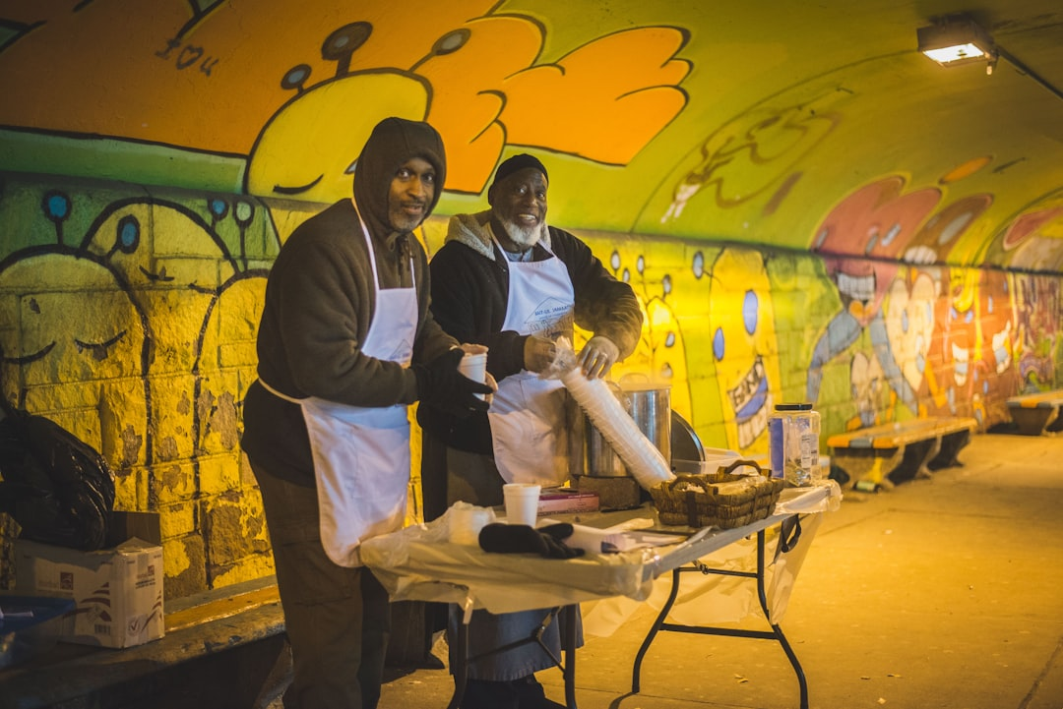
By ensuring community service outreach is taking seriously.

Slide 12

By organizing community outdoor programs at major Gare, Parks etc.

Slide 13

FORMATS OF EVANGELSM
Digital Evangelism : leveraging the social media to create evangelistic centered contents
Including:
Podcast
Digital graphical designs

Slide 14
KEY DEPARTMENTAL PARTNER FOR EVANGELISM
Media (Contents and designs)
Choir (Outdoor musical evangelism)
Prayer (Always pray for Souls)
Hospitality (Handles logistics for outdoor outreaches (Prison & Hospital))

Slide 15
EVENTS DATE
EVENTS | DATES
Hospital | 26th/04/2025
Open Air Worship Event | 23rd/08/2025
Prison | 13th/12/2025

Slide 16

NOTE
The existing strategy such as the games night, Seminars still continues.

Slide 17

Thank You

